Slide 1
Heat and Mass balance
Tips and Tricks!
Technical Development Program
SPREAD 2016

Slide 2
Critical points during measurements
Kiln dust loss
Clinker weigh out
Clinker temperature
Cooler waste air temperature
Temperature measurements
Gas analysis
Radiation measurement

Slide 3
Mass flow measurements
Kiln dust loss
Done before/ after the heat balance
Raw mill is shut down for > 1 h before measurement is started
At least 1 full truck is weighted and required time is recorded
Conditioning tower dust needs to be measured too, if it is not included in filter dust already
Clinker rate
Weigh out is typically done with trucks and weight bridge
For at least 12h
Do not overfill trucks (clinker loss during transport to weight bridge)

Slide 4
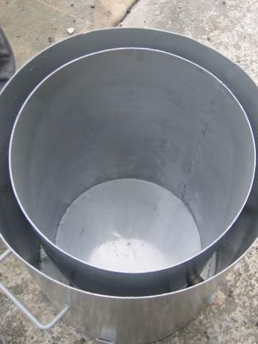
Clinker temperature
Insulated box method
Coating included but no direct contact with thermocouple

Slide 5
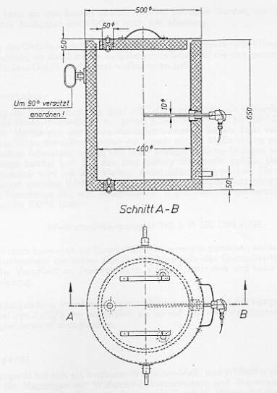
Clinker temperature box
Insulated box
(Measuring box according to VDZ guidelines)

Slide 6
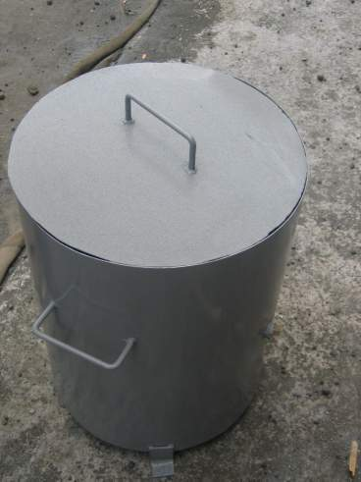
Clinker temperature box
Thermocouple (tip in center of sample)

Slide 7
Enough samples are required..
Exclude outliers!

Slide 8
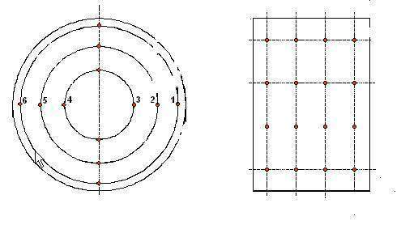
Temperature of cooler waste air
Measure temperature close to the cooler
Do cross check with temperature at the heat exchanger inlet (radiation of crushed clinker on roller crusher)
Consider peaks in measurement for averaging (e.g. use datalogger with different temperature probes connected)
Average gas temperatures of the entire cross section (similar to Prandtl measurement) and compare to fix installed temperature measurement
Avoid extracting cooler middle air during heat balance

Slide 9
Temperature measurements
Temperature of fuel and transport air
Measure surface temperature of fuel transport duct close to main or calciner burner with contact thermometer
Temperature of tertiary air
Measure close to the cooler (temperature drop due to radiation and convection losses of tertiary air duct)
Do not measure in kiln hood (radiation from clinker)
Temperature of the kiln feed
Measure before rotary valve
If no port is available use contact thermometer

Slide 10
Gas properties measurements
Gas properties at preheater outlet double cyclones:
Measure gas composition and temperature of each cyclone
Do cross check in downcomer
Calciner exit (measured after bottom stage cyclone)
Water cooled, ceramic or special steel type probe
Check representativity of your measurement
Kiln inlet
Only water cooled or ceramic probes withstand temperature
Check representativity of measurement

Slide 11
Radiation and convection
Emissivity needs to be adjusted to surface!
Crosscheck temperature of pyrometer with temperature measured with contact thermometer on painted surfaces
Use outer enveloping cylinder area for radiation loss of satellite coolers
Enveloping cylinder of satellite coolers

Slide 12
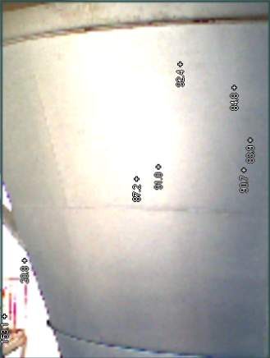
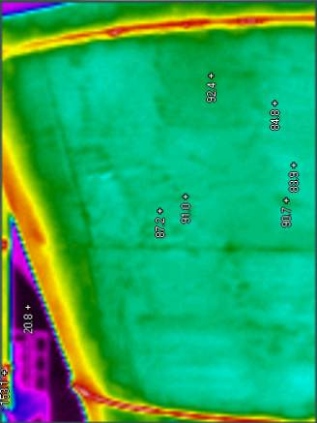
Emissivity of painted surfaces
Even with new painting influence observed

Slide 13
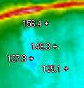
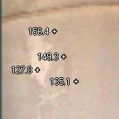
Painting influence

Slide 14
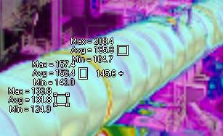
Influence of emissivity
ε = 0.9
ε = 0.7
ε = 0.5

Slide 15
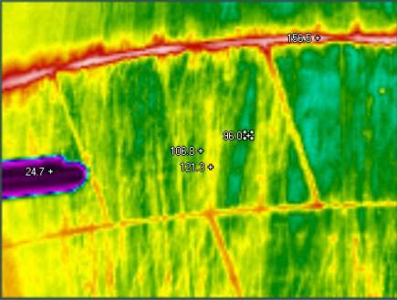
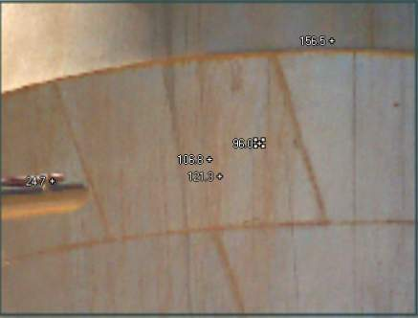
Influence of dirt

Slide 16
Comparison of different emissivities and wind speeds
Kiln shell segment

Slide 17
Typical Emissivity Factors (ε)
Type of surface Temperature ε
Rough oxidized steel 100°C 1.0
Rough oxidized steel 400°C 0.9
White lime paint (on steel) 400°C 0.8
Aluminum paint (weathered) 100°C 0.4 - 0.7
Aluminum paint (new) 100°C 0.2 - 0.4
Al jacket (rolled sheet material) 100 - 500°C 0.08
Al jacket (polished / bright foil) 100 - 500°C 0.04
→ Set correct emissivity factor ε on pyrometer if ε is set too high, Pyrometer indicates too low if ε is set too low, Pyrometer indicates too high
e.g. kiln shell, satellites
e.g. cyclone shell, calciner

Slide 18
Procedure for evaluation of Heat / Mass balance
Compile all gas and mass flow measurements and convert them on a normalized, average hourly basis
Average all temperature measurements and gas analyses using PLC / TIS data and correct average where necessary by offset
Average data from lab
Fill in raw data in HBL spreadsheet
Tune heat balance in the following order:
Mass balance
Cooler air balance
Cooler heat balance
Kiln system heat balance

Slide 19
Tuning mass balance
Error < 1 %: good
Error < 3 %: satisfactory
Error > 3 %: unsatisfactory
If unsatisfactory, check:
Clinker weight carried out:
Kiln feed/clinker factor reasonable?
Kiln heat consumption reasonable?
All dust losses reasonable and considered?
LOI of kiln feed and dust losses reasonable?
LOI of clinker set to 0 % (weighted clinker LOI free)?
If unsatisfactory error persists
Recheck calibration of feeders and scales
Repeat mass balance only
No clinker weight carried out:
Calculate clinker rate by setting mass balance error to zero
Kiln feed / clinker factor reasonable?
Kiln heat consumption reasonable?

Slide 20
Mass balance guide values
 | Guide value | Comment
Kiln feed / clinker factor | 1.6 – 1.75 | Mostly dependent on PH (and bypass) dust loss High values of kiln feed LOI (> 35.5 – 36.0 %) only explicable if high LSF, high MgCO3 or burnable matter For high bypass dust rates, higher values possible
Cyclone efficiency | 90 – 95 % | Mainly a function of cyclone design, dip tube velocity, dip tube length, efficiency 2nd highest cyclone stage, kiln feed fineness (….)

Slide 21
Tuning cooler air balance
Error < 1 %: good
Error < 3 %: satisfactory
Error > 3 %: unsatisfactory
If unsatisfactory, check:
Airflow measurement done:
Prandtl measurement point at waste air duct adequate and temperature representative
Measured cooler middle air flow reasonable?
Additional false air (e.g. AA-HE, filter, etc.) considered?
Cooler air flow vs. clinker end temperature reasonable?
False air (kiln hood, cooler, crusher) considered?
If unsatisfactory error persists
Calculate waste air by zeroizing air balance error
No flow measurement:
Adjust waste air flow to set air balance error zero
Check the following points:
Cooler air flow versus clinker end temperature reasonable?
False air in kiln hood, cooler crusher considered?

Slide 22
Cooler air balance
Typical correlation in-between cooler air flow and clinker end temperature for judgment of specific cooler air flow rate
Conventional grate cooler (old design)
Modern, high efficient cooler (new design)

Slide 23
Cooler air balance guide values
 | Guide value | Comment
False air | Kiln inlet seal: 0.02 – 0.05 Nm3/kg cli Kiln hood: 0.01 – 0.03 Nm3/kg cli Cooler: 0.03 –0.05 Nm3/kg cli | Values refer to normal operating conditions (kiln hood pressure: - 0.5 to - 1.0 mbar kiln inlet pressure: - 2 to - 5 mbar) and a normal tight kiln system In case of lower (less negative) pressures, lower values acceptable In case of “big holes and gaps”, higher values acceptable Check clinker crusher for false air intake!!! Check tightness of pressurized double pendulum flaps / internal drag chain under grate (negative false air input!!)

Slide 24
Tuning cooler heat balance
Error < 1 %: good
Error < 3 %: satisfactory
Error > 5 %: unsatisfactory
If unsatisfactory, check:
Secondary air typically not measured
Influence of radiation from hot clinker bed on measured temperature
Secondary air temperature used as fitting parameter to minimize cooler heat balance error
Check the following points:
Difference in-between secondary and tertiary air temperature reasonable? (<100 °C if common take off point)
Normalized cooler efficiency reasonable?
Clinker end temperature reasonable?
Radiation loss of satellite cooler reasonable (~250 – 350 kJ/kg cli)
If results are not reasonable:
Waste air temperature at border limit (close to cooler extraction) representative (average of entire cross section)??
Tertiary air temperature measurement representative?
False air (kiln hood, cooler, crusher) considered correctly??
Cooler air flow vs. clinker end temperature reasonable??

Slide 25
Cooler heat balance guide values
 | Guide value | Comment
Normalized cooler efficiency (based on 0.8 Nm3/kg cli) | Modern grate cooler: 70 – 75 % Conventional grate cooler: 55 – 70 % Satellite cooler: 55 – 65 % (tube only) 60 – 70 % (incl. kiln internal cooling zone) | Efficiency of the cooler depends strongly on the condition (e.g. gap width in-between plates / seals) and design of the cooler (e.g. installation of fixed inlet), on the clinker granulometry (and porosity) as well as on operating conditions (no red rivers, geysers,….)

Slide 26
Tuning kiln heat balance
Balance error:
Error < 1 %: excellent
Error < 3 %: good
Error > 5 %: unsatisfactory
Check the following points:
Kiln exhaust gas and cooler waste air losses reasonable?
Heat of clinker formation reasonable (default: 1750 kJ/kg)?
Burnable matter in kiln feed (TOC, pyrite) considered?
Radiation and convection losses reasonable?
Recheck calibration of fuel feeders and NCV determination
If unsatisfactory error persists:
Repeat heat balance

Slide 27
Kiln heat balance guide values
 | Guide value | Comment
Specific heat consumption of kiln system | 4 stage PH or PC kiln: 3200 – 3500 kJ/kg cli 5 stage PH or PC kiln: 3100 – 3400 kJ/kg cli | Increased heat consumption due to AFR usage not considered

